Slide 1
HOMEWORK 7 Due 5/29 00:00 send to e3

Slide 2
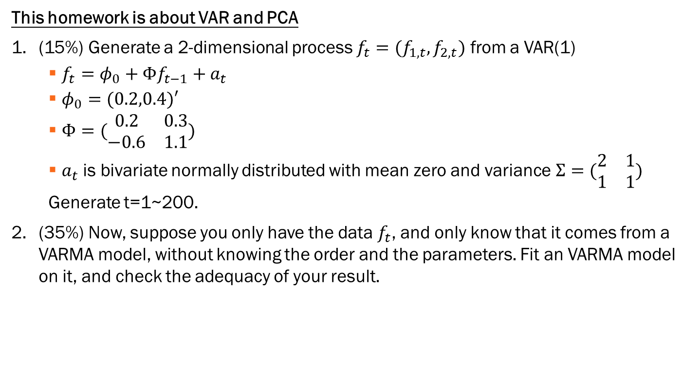
This homework is about VAR and PCA
(15%) Generate a 2-dimensional process ${f_{t}=(f}_{1,t}, f_{2,t})$ from a VAR(1)
$f_{t}=φ_{0}+Φf_{t−1}+a_{t}$
$φ_{0}=(0.2,0.4)′$
$Φ=(\begin{matrix}0.2 & 0.3 \\ −0.6 & 1.1\end{matrix})$
$a_{t}$ is bivariate normally distributed with mean zero and variance$Σ=(\begin{matrix}2 & 1 \\ 1 & 1\end{matrix})$
Generate t=1~200.
(35%) Now, suppose you only have the data $f_{t}$, and only know that it comes from a VARMA model, without knowing the order and the parameters. Fit an VARMA model on it, and check the adequacy of your result.

Slide 3
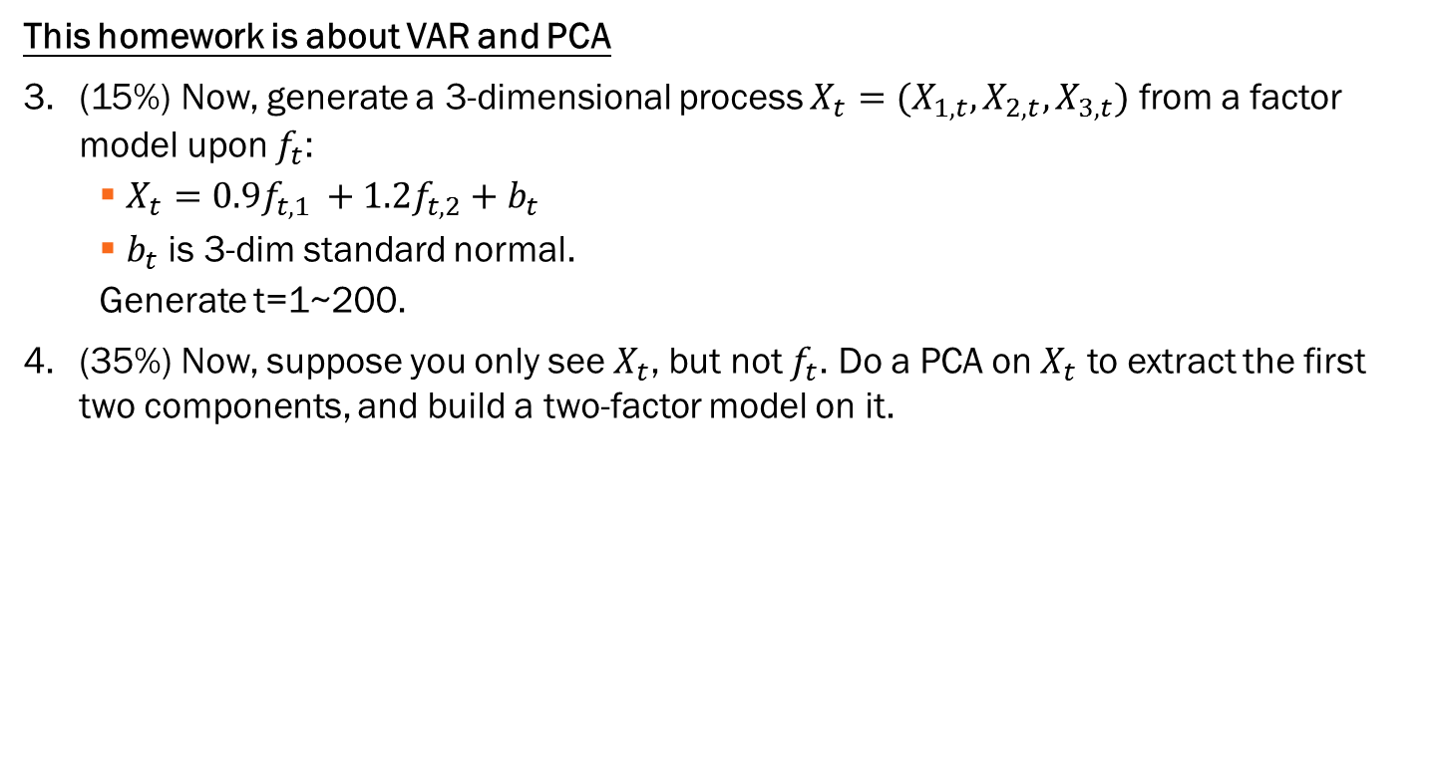
This homework is about VAR and PCA
(15%) Now, generate a 3-dimensional process ${X_{t}=(X}_{1,t}, X_{2,t},X_{3,t})$ from a factor model upon $f_{t}$:
$X_{t}=0.9f_{t,1 }+1.2f_{t,2}+b_{t}$
$b_{t}$ is 3-dim standard normal.
Generate t=1~200.
(35%) Now, suppose you only see $X_{t}$, but not $f_{t}$. Do a PCA on $X_{t}$ to extract the first two components, and build a two-factor model on it.

